Slide 1
REST API basics and examples with JS and JQUERY

Slide 2
Outline
What are the APIs
REST API Basics
JSON overview
JSON vs XML
JSON JQuery Syntax
A Simple Application
The More General Method
JSON Validation
Conclusions
DEMO

Slide 3
API – Application Programming Interface
1) What is an API?
API is a contract. A promise to perform described services when asked in specific ways.
2) How is it used?
According to the rules specified in the contract. The whole point of an API is to define how it's used.
3) When and where is it used?
It's used when 2 or more separate systems need to work together to achieve something they can't do alone.
Wheater Example
Without API
Weather application must open weather.com site and read the details as human does.
With API
Weather application will send a message to weather.com and receives the result and then display it.

Slide 4
RESTful API
Virtually a good API allows us to do all these operations without the need to have access directly to the database or to the solution implemented for saving the information.
GET this allows us to request a certain data set to the server;
POST the ability to create a new object within the database;
PUT with this we can completely modify or replace an existing object;
DELETE that is, we can remotely delete an object contained within the database to which we are connected.

Slide 5
REST - REpresentational State Transfer
REST vs RESTful
REST è REpresentational State Transfer, that is, a representation of the state transfer of a given data.
This is because REST is not a technology but rather describes a set of guidelines and approaches that define the style in which data is transmitted.
As a good developer, what you can do is create an API set that respects the logic set by REST by creating a set of RESTful APIs.

Slide 6
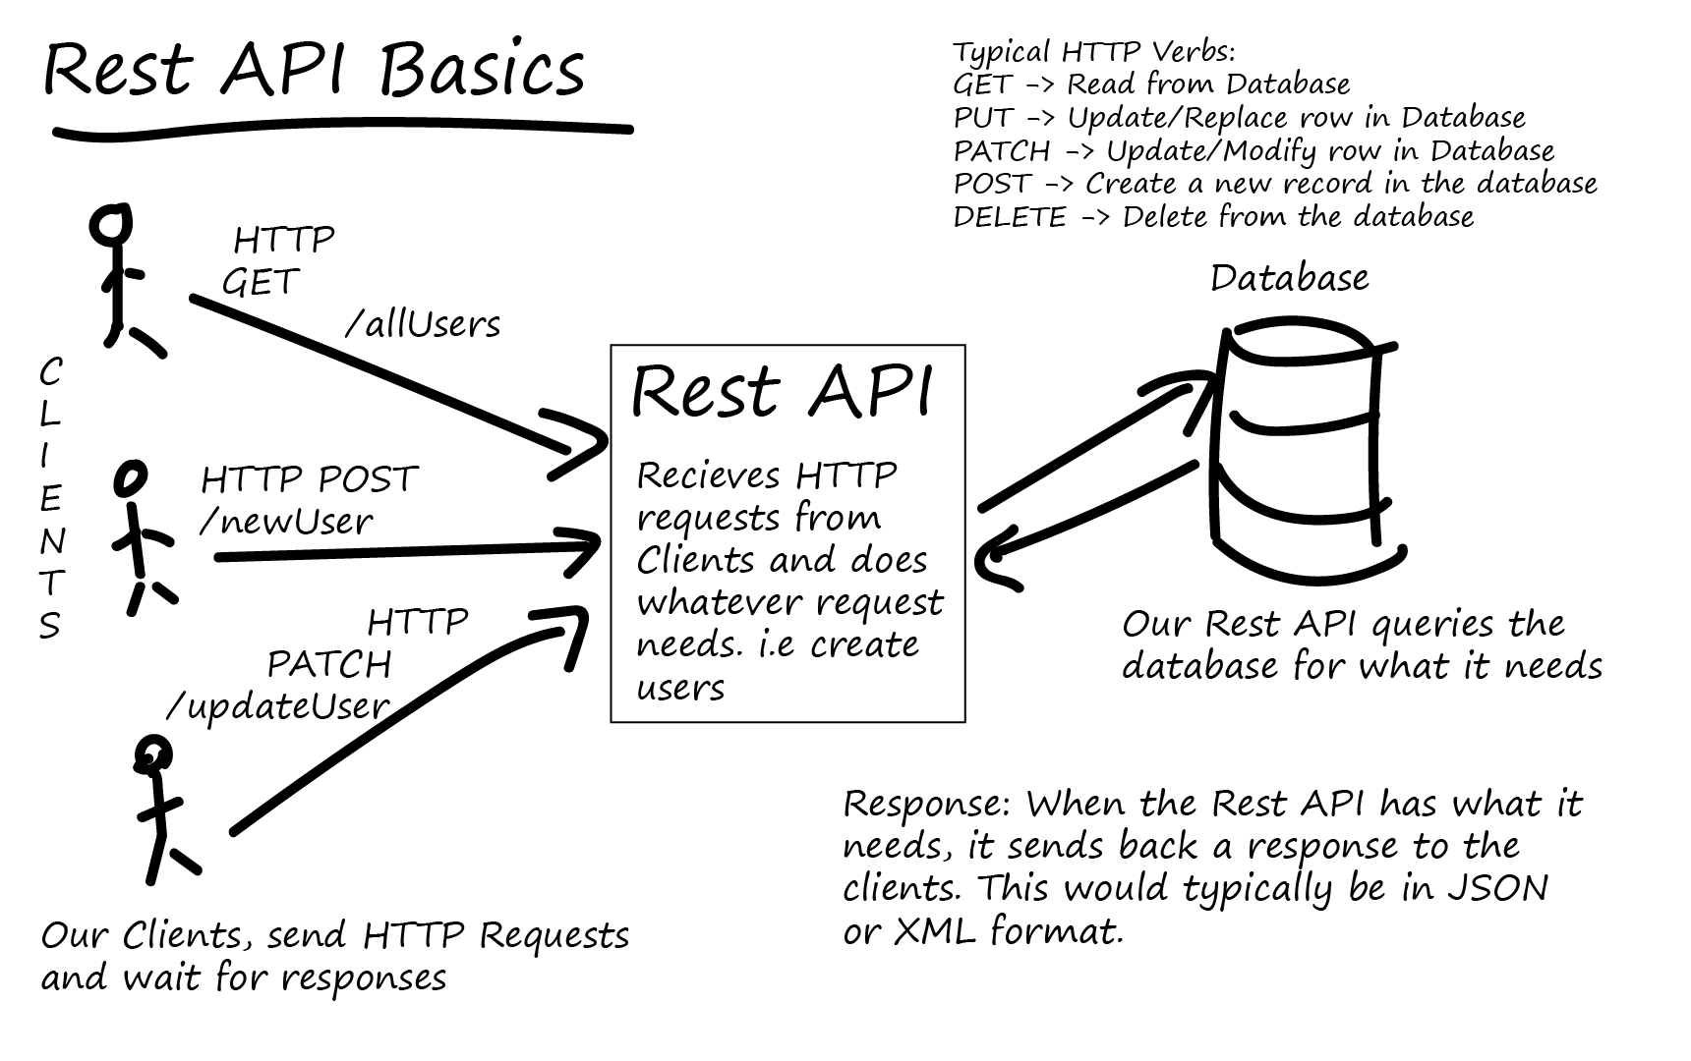
REST Basics
Most, if not all, large popular websites will rely upon some form of REST API in order to deliver some content or functionality to their users.
We can communicate with REST APIs using HTTP requests, much like you’d do to navigate to a website or load an image. We can do HTTP requests to certain API urls and these urls would then return the information we required, or we could push data to an API url in order to change some data in a database.
Typically we send HTTP requests to an URL that we have defined in our REST API and it would either perform a given task for us or return a certain bit of data. Most APIs these days would return a response to us in the form of XML or JSON.

Slide 7
RESTful Applications
Some points that are generally present within any such application :
there is a certain consistency within the entire API;
developing this solution does not involve creating sessions within our servers, thus creating a stateless existence where our server, between one operation and another, does not save login information;
when appropriate HTTP status codes are used that help and speed up the responses of our servers;
endpoint URLs that follow a given logic are created;
the API version is saved in URLs rather than within HTTP status codes.

Slide 8
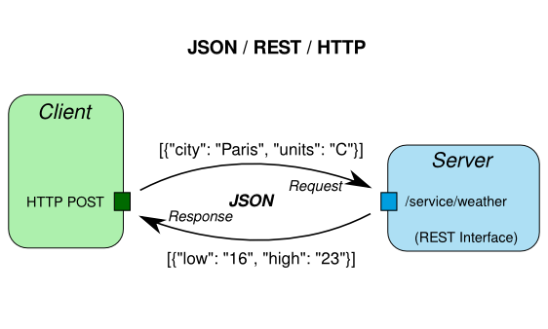
What is JSON?
JSON stands for JavaScript Object Notation.
In simple terms JSON is a way of formatting data for, e.g., transmitting it over a network.
We will look at loading JSON data using an HTTP GET request

Slide 9
JSON vs XML
Why would we choose JSON over say XML?
The key advantage of using JSON is efficiency. JSON is less verbose and cluttered, resulting in fewer bytes and a faster parse process. This allows us to process more messages sent as JSON than as XML.
Moreover, JSON has a very efficient and natural object representation leading to formats such as BSON, where JSON-like objects are stored in a binary format.
Notes:
ingombrante

Slide 10
JSON jQuery Syntax
Now let’s see how jQuery can help us load JSON-encoded data from a remote source.
The $.getJSON() method is a handy helper for working with JSON directly if you don’t require much extra configuration. Essentially, it boils down to the more general $.ajax() helper, with the right options being used implicitly.
The method signature is:
Besides the required URL parameter we can pass in two optional parameters. One represents the data to send to the server, the other one a callback to trigger in case of a successful response.
So the three parameters correspond to:
The url parameter is a string containing the URL to which the request is sent.
The optional data parameter is either an object or a string that is sent to the server with the request.
The optional success(data, textStatus, jqXHR) parameter is a callback function executed only if the request succeeds.
$.getJSON(url, data, success);

Slide 11
JSON JQuery Syntax
In the simplest scenario we only care about the returned object.
In this case, a potential success callback would look like this:
As mentioned, the same request can be triggered with the more verbose $.ajax() call.
Here we would use:
function success(data) {
// do something with data, which is an object
}
$.ajax({
dataType: 'json',
url: url,
data: data,
success: success
});

Slide 12
A Sample Application
The Sample JavaScript
This code is the complete client-side logic.
It waits for the DOMContentLoadedloaded event before attaching an event handler to the click event of the element with the ID get-data.
When this element is clicked we attempt to load the JSON from the server using $.getJSON(), before processing the response and displaying it on the screen.
$(document).ready(function () {
$('#get-data').click(function () {
var showData = $('#show-data');
$.getJSON(’json/slides.json', function (data) {
console.log(data);
var items = data.items.map(function (item) {
return item.key + ': ' + item.value;
});
showData.empty();
if (items.length) {
var content = '<li>' + items.join('</li><li>') + '</li>';
var list = $('<ul />').html(content);
showData.append(list);
}
});
showData.text('Loading the JSON file.');
});
});

Slide 13
A Sample Application
The Sample JavaScript
Besides converting parts of the object to an unordered list, the full object is also printed in the browser’s debugging console.
The output is generated in the <div> element with the ID show-data. Even though the element is being reset for every request, we only fill it if the resulting JSON object contains any items at all. Of course, for our example the data is fixed, however, in general any kind of response is possible.
Note that we also set some text for the output <div>. If we insert some (artificial) delay for the JSON retrieval, we will see that this actually executes before any result of the $.getJSON request is displayed. The reason is simple: By default $.getJSON is non-blocking, i.e., async. Therefore, the callback will be executed at some (unknown) later point in time.
$(document).ready(function () {
$('#get-data').click(function () {
var showData = $('#show-data');
$.getJSON(’json/slides.json', function (data) {
console.log(data);
var items = data.items.map(function (item) {
return item.key + ': ' + item.value;
});
showData.empty();
if (items.length) {
var content = '<li>' + items.join('</li><li>') + '</li>';
var list = $('<ul />').html(content);
showData.append(list);
}
});
showData.text('Loading the JSON file.');
});
});

Slide 14
A Sample Application
The Sample JavaScript
Distilling the source to obtain the crucial information yields the following block:
$('#get-data').click(function () {
$.getJSON(’json/slides.json', function (data) {
console.log(data);
});
});
Here we only wire the link to trigger the start of the $.getJSON helper before printing the returned object in the debugging console.

Slide 15
A Sample Application
The Sample JSON
The sample JSON file is much larger than the subset we care about. Nevertheless, the sample has been constructed in such a way, to show most of the JSON grammar. The file reads:
In the sample JavaScript, we are only using the array associated with the items key.
In contrast to ordinary JavaScript, JSON requires us to place keys in double-quotes. Additionally, we cannot use trailing commas for specifying objects or arrays.
However, as with ordinary JavaScript arrays, we are allowed to insert objects of different types.
{
"items": [
{
"key": "First",
"value": 100
},{
"key": "Second",
"value": false
},{
"key": "Last",
"value": "Mixed"
}
],
"obj": {
"number": 1.2345e-6,
"enabled": true
},
"message": "Strings have to be in double-quotes.”
}

Slide 16
A Sample Application
The Sample Webpage
We already looked at the script and the sample JSON file. All that’s left is the webpage which provides the parts being used by the JavaScript file to trigger and display the JSON file.
We use the minified version of jQuery from the official webpage.
Then we include our script, which is responsible for injecting the logic.
Note: As we are including our JavaScript files in the correct place (just before the closing </body> tag), it no longer becomes necessary to use a $(document).ready() callback, because at this point, the document will be ready by definition.
<!DOCTYPE html>
<html>
<head>
<meta charset="utf-8">
<title>Request JSON Test</title>
</head>
<body>
<a href="#" id="get-data">Get JSON data</a>
<div id="show-data"></div>
<script src="http://code.jquery.com/jquery-1.9.1.min.js"></script>
<script src=”js/slides.js"></script>
</body>
</html>

Slide 17
The More General Method
As already mentioned, the $.ajax method is the real deal for any (not only JSON related) web request.
This method allows us to explicitly set all the options we care about.
We can adjust async to true if we want this to call to run concurrently, i.e., the run potentially at the same time as other code. Setting it to false will prevent other code from running while the download is in progress.
The overrideMimeType method (which overrides the MIME type returned by the server) is only called for demonstration purposes. Generally, jQuery is smart enough to adjust the MIME-type according to the used data type.
$.ajax({
type: 'GET',
url: filename,
data: data,
async: false,
beforeSend: function (xhr) {
if (xhr && xhr.overrideMimeType) {
xhr.overrideMimeType('application/json;charset=utf-8');
}
},
dataType: 'json',
success: function (data) {
//Do stuff with the JSON data
}
});

Slide 18
JSON Validation
Usually, we will not request a static JSON file, but will load JSON which is generated dynamically (for example as the result of calling an API). The JSON generation is dependent on some parameter(s), which have to be supplied beforehand.
Here we check the status to ensure that the result is indeed the object returned from a successful request and not some object containing an error message. The exact status code is API-dependent, however, for most GET requests a status code of 200 is usual.
The data is supplied in the form of an object, which leaves the task of creating the query string (or transmitting the request body) up to jQuery. This is the best and most reliable option.
var url = 'https://api.github.com/v1/...';
var data = {
q: 'search',
text: 'my text'
};
$.getJSON(url, data, function (data, status) {
if (status === 200) {
//Do stuff with the JSON data
}
});

Slide 19
JSON Validation
Common $.getJSON Errors
Silent failures on $.getJSON calls: This might happen if, e.g., jsoncallback=json1234 has been used, while the function json1234() does not exist. In such cases the $.getJSON will silently error. We should therefore always use jsoncallback=? to let jQuery automatically handle the initial callback.
In the best case real JSON (instead of JSONP) is used (either by talking with our own server or via CORS). This eliminates a set of errors potentially introduced by using JSONP. The crucial question is: Does the server / API support JSONP? Are there any restrictions on using JSONP?
Uncaught syntax error: Unexpected token (in Chrome) or invalid label (in Firefox). The latter can be fixed by passing the JSON data to the JavaScript callback. In general, however, this is a strong indicator that the JSON is malformed. Consider using JSONLint as advised above.
Notes:
The big question is now: How do we detect if the error actually lies in the transported JSON?

Slide 20
JSON Validation
How to fix JSON Errors
There are three essential points that should be covered before starting any JSON-related debugging:
We have to make sure that the JSON returned by the server is in the correct format with the correct MIME-type being used.
We can try to use $.get instead of $.getJSON as it might be that our server returns invalid JSON. Also if JSON.parse() fails on the returned text we immediately know that the JSON is to blame.
We can check the data that is being returned by logging it to the console. This should then be the input for further investigations.
Debugging should then commence with the previously mentioned JSONLint tool.
Notes:
The big question is now: How do we detect if the error actually lies in the transported JSON?

Slide 21
Conclusion
JSON is the de-facto standard format for exchanging text data.
JQuery’s $.getJSON() method gives us a nice little helper to deal with almost any scenario involving a request for JSON formatted data.
We investigated some methods and possibilities that come with this handy helper.
DEMO!
http://bootstrap-table.wenzhixin.net.cn/getting-started/

